Slide 1
@MrHinsh
martinhinshelwood
nakedagility.tv
Notes:
Hi, my name is Martin Hinshelwood and I run Naked Agility with Martin Hinshelwood. I’m a professional scrum trainer with Scrumorg, Professional Kanban Trainer with ProKanban, and I have been a Microsoft MVP in DevOps for 13 years. Id like to take about the tyranny of Taylorism and how to detect agile bs!
I’d like to thank StackConf for this opportunity to talk to you. Please feel free to ask any questions in the chat, Ill be there, or at any time on twitter @MrHinsh. You can even find many other webcasts of mine on nakedagility.tv. I’ll be providing a link to the presentation at the end that will include much more information about the Azure DevOps teams evolution to agility/.

Slide 2
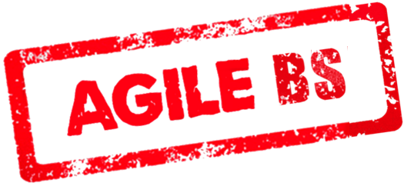
81% of all development shops say that they are agile!
Almost 81% of them are lying!
Dealing with Development Team Dysfunction, Forrester Research 2017
So how can we tell the real from the…
@MrHinsh

Slide 3
81% of all development shops say that they are agile!
“only 22% do short iterations”
Dealing with Development Team Dysfunction, Forrester Research 2017
That’s…
@MrHinsh

Slide 4
81% of all development shops say that they are agile!
“only 16% have ordered backlogs”
Dealing with Development Team Dysfunction, Forrester Research 2017
That’s…
@MrHinsh

Slide 5
81% of all development shops say that they are agile!
“only 13% do retrospectives”
Dealing with Development Team Dysfunction, Forrester Research 2017
That’s…
@MrHinsh

Slide 6
Dealing with Development Team Dysfunction, Forrester Research 2017
Notes:
Why bother scaling these?

Slide 7
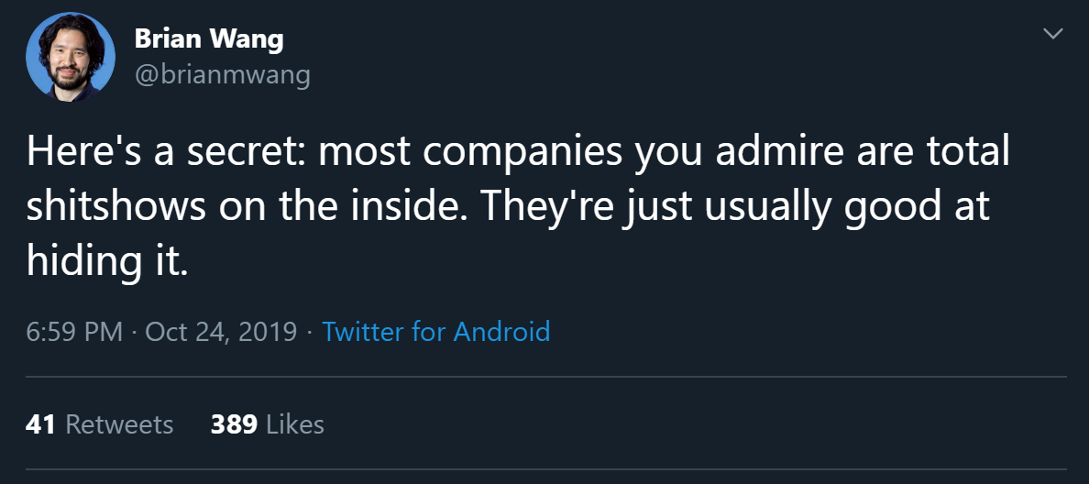

Slide 8
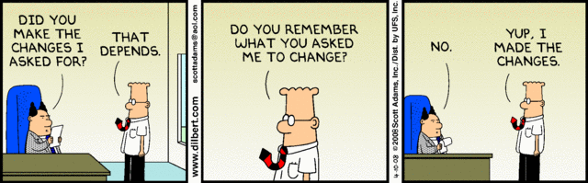
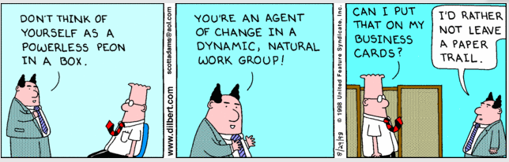
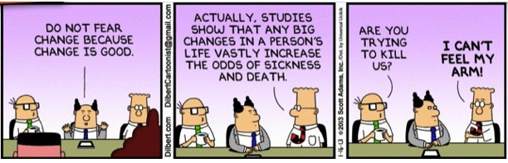
Why is it so hard to change?

Slide 9
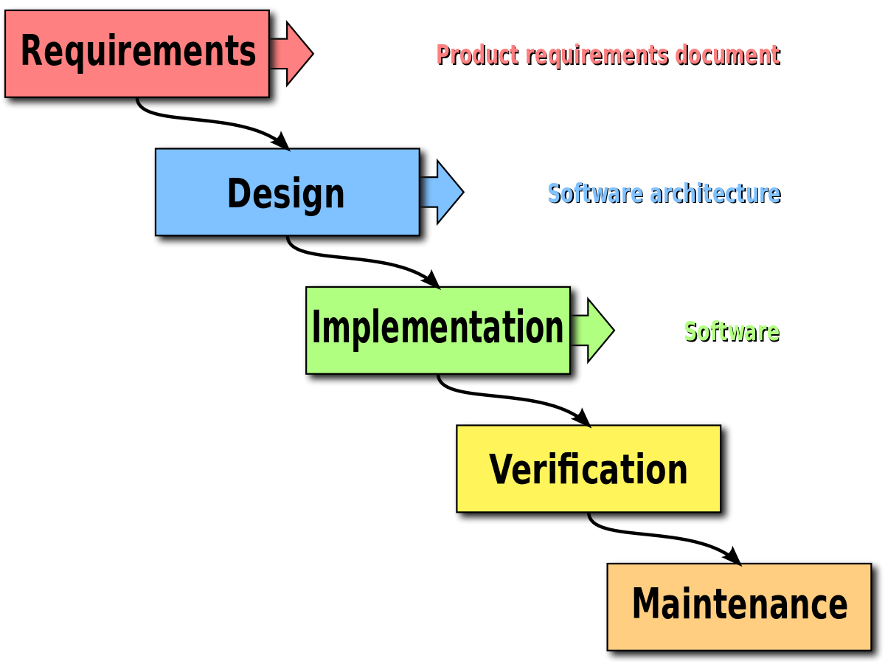
The Tyranny of Taylorism: How we got here

Slide 10
“Why we work the way we work”
A 130 year timeline from the 1880’s to today

Slide 11
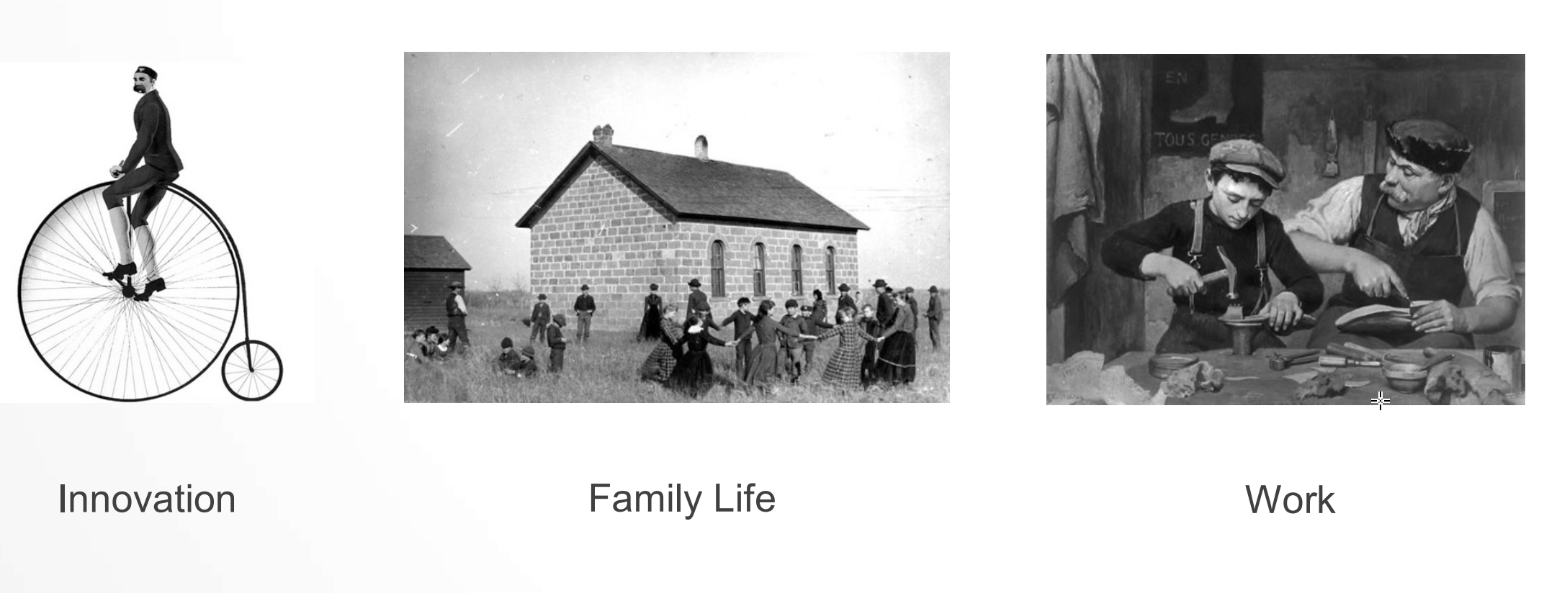
Pre-1890’s
Notes:
Coach's Notes: Why this slide is important
Prior to the industrial revolution, manufacturing took place at or near home in small workshops. Compensation came through earned value and was based on how well a person made a product or how useful it was to the buyer. In other words there was PURPOSE to the people’s work. MASTERY, enabled by the Master and Apprentice system ensured that quality was passed on through generations. People could choose to work hard and well or get better at what they did and their application to the same would often manifest itself in either increased wealth or greater time to pursue other interests

Slide 12
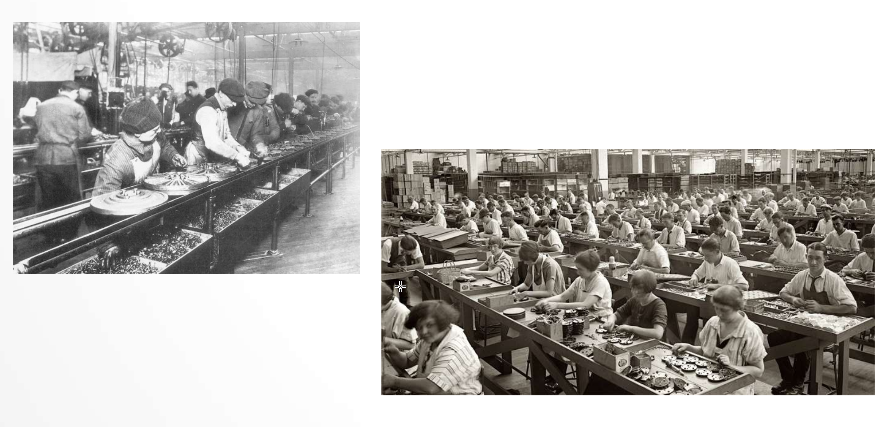
The Industrial Revolution – a time of wealth creation

Slide 13
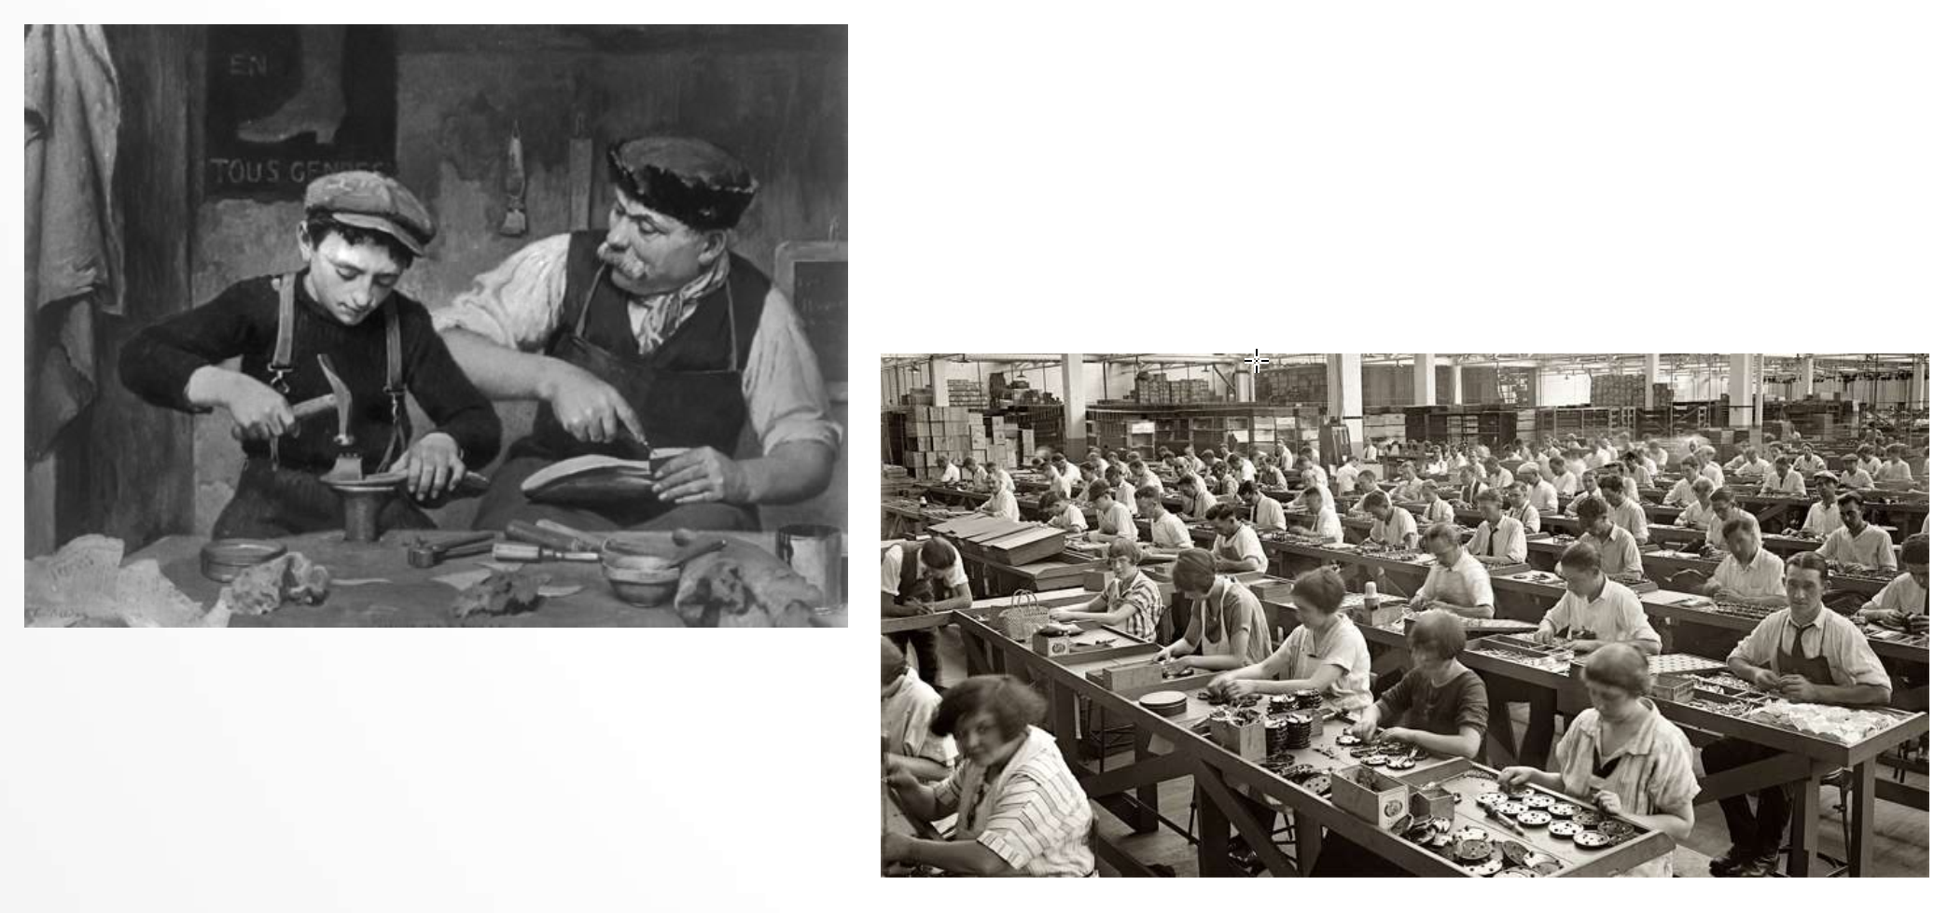
What is the difference?

Slide 14
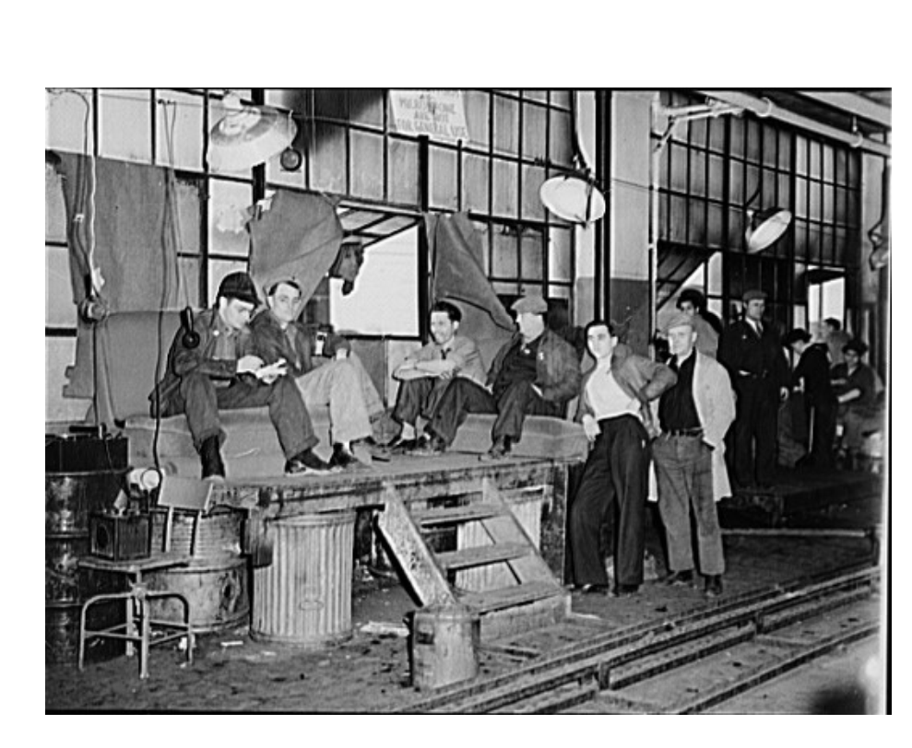
Mechanising the workplace resulted in disengaged people
Soldiering The biggest perceived impediment to productivity and wealth creation at the time
Meaning: “To work more slowly than one's capacity. To loaf or to malinger.”

Slide 15
Let’s defeat Soldiering in 1890
You are a management consultant circa 1890.
You have been hired by a coal mine or paper mill owner to improve productivity lost from soldering.
Write down as many ideas that could be used to defeat soldiering in a Paper Mill or Coal Mine
Note: You do not have to be politically correct – think as if you’re in the late 1800’s
2
Notes:
Purpose
ToDo
Take Away
ToDo
Discussion
ToDo

Slide 16
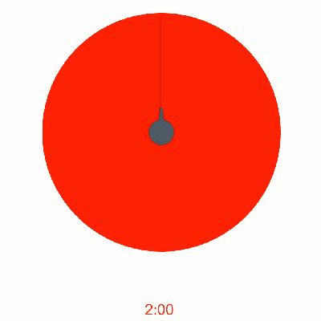
Let’s defeat Soldiering in 1890
You are a management consultant circa 1890.
You have been hired by a paper mill owner to improve productivity lost from soldering.
Turn to the person next to you and come up with as many ideas to defeat this perceived malingering workforce.
Note: You do not have to be politically correct – think as if you’re in the late 1800’s
2
Notes:
Purpose
ToDo
Take Away
ToDo
Discussion
ToDo

Slide 17
Let’s defeat Soldiering in 1890
You are a management consultant circa 1890.
You have been hired by a paper mill owner to improve productivity lost from soldering.
https://nkdagility.net/Soldiering1980
Use the link above and create as many many ideas as postits in Mural to defeat this perceived malingering workforce.
If you can de-dup as you go!
Note: You do not have to be politically correct – think as if you’re in the late 1800’s
2
Notes:
https://nkdagility.net/Soldiering1980

Slide 18
Let’s defeat Soldiering in 1890
You are a management consultant circa 1890.
You have been hired by a paper mill owner to improve productivity lost from soldering.
https://nkdagility.net/Soldiering1980
Use the link above and create as many many ideas as postits in Mural to defeat this perceived malingering workforce.
If you can de-dup as you go!
Note: You do not have to be politically correct – think as if you’re in the late 1800’s
2
Notes:
Purpose
ToDo
Take Away
ToDo
Discussion
ToDo

Slide 19
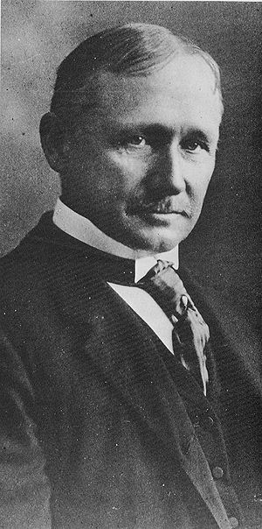
Thought leaders of the time: Frederick Winston Taylor
“Hardly a competent worker can be found who does not devote a considerable amount of time to studying just how slowly he can work and still convince his employer that he is going at a good pace”
-Frederick Winslow Taylor

Slide 20
Taylor invented the Scientific Management Method
All the ideas you just wrote down guided his thinking
Developed standard methods for performing each job
Divided workers into appropriate ability based groups foreach job
Trained workers in standard methods
Removed thinking, planned their work
Created wage incentives for increased output

Slide 21
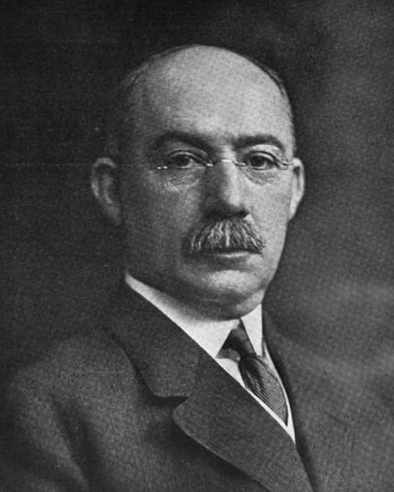
Henry Gantt
A disciple of Frederick Winslow Taylor
Used Scientific analysis to improve efficiency in industry
Created the Task and Bonus’ system of wage payment
Created the Basic wage based on expected low performance
Created bonuses for meeting or exceeding expected proficiency
Gave bonuses to managers for "motivating" their staff to exceed proficiency

Slide 22

The modern School System
Rewards for fulfilling tasks
Everyone sits in Rows
Everyone has to do the same thing at the same time
No talking
Incentive based learning

Slide 23
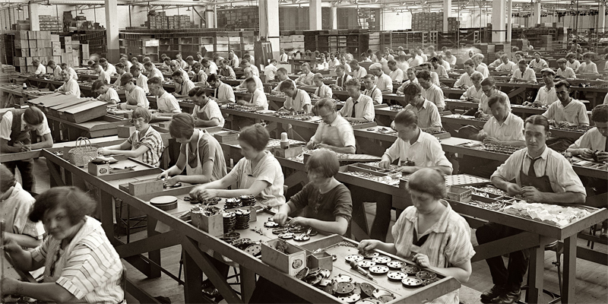
The modern School System

Slide 24
Optimised for Output not Outcome

Slide 25
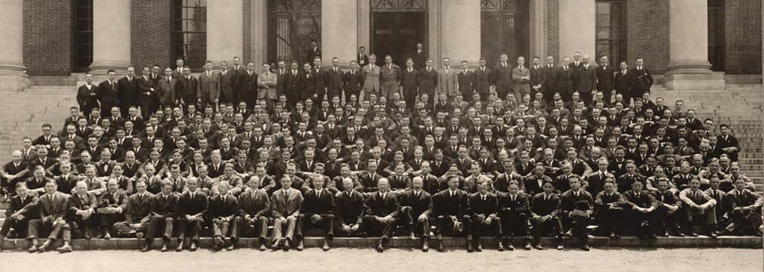
1908 Harvard Graduate School of Business Administration
Expands on Taylor’s work to create the first MBA!
These wealthy leaders flock into organizations world wide and Taylorism spreads

Slide 26

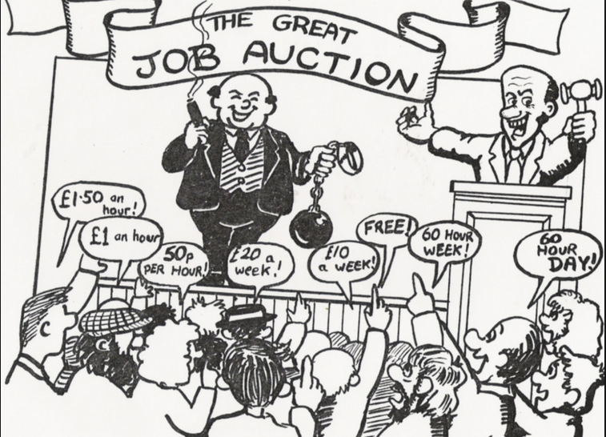






50’s A new way of working emerges
Analysis
Design
Divide the workforce into specific skills
Create things sequentially
Tell them how to do the work
Encourage them to specialize in just one thing
Reward them based on individual output
Implementation
Testing
Maintenance
Sequential Working
Complete your stage then pass it to the next department

Slide 27
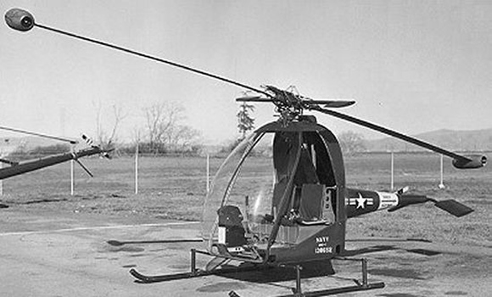
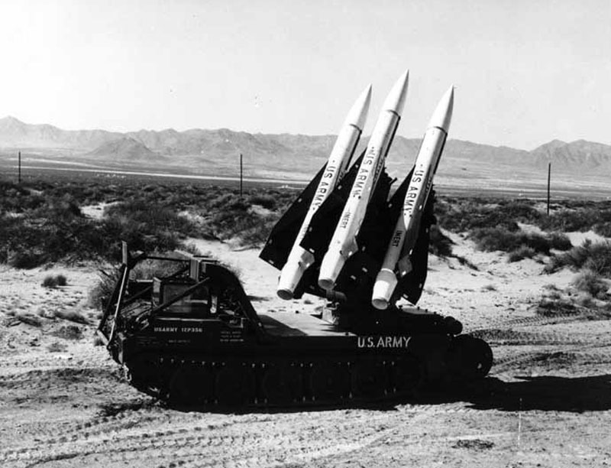
1950’s - US Military Complex – The largest buyer

Slide 28
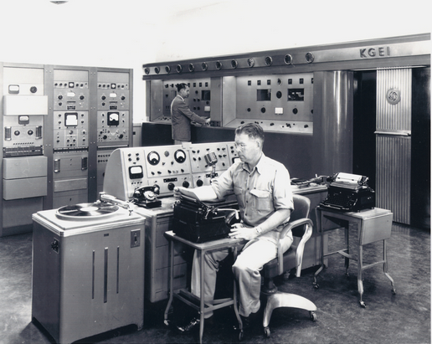
US Military Complex – 1950’s Adopts Sequential Predictive Development (Waterfall)
Analysis
Design
Implementation
Testing
Maintenance
Sequential Working
Complete your stage then pass it to the next department
Notes:
Coaches’ notes:
The US Military complex became the largest purchaser of services and goods as the focus turned towards the defeat of communism after the second world war.
They created processes based on the works of Taylor and Gantt rewarding suppliers and contractors based on the incentives model

Slide 29
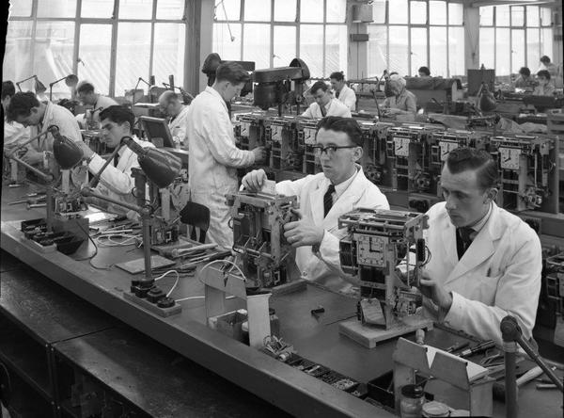

It becomes part of their procurement process
They demand all suppliers must work in the same way - Sequentially
Sequential Working
Complete your stage then pass it to the next department

Slide 30

Then they applied it to software development

Slide 31
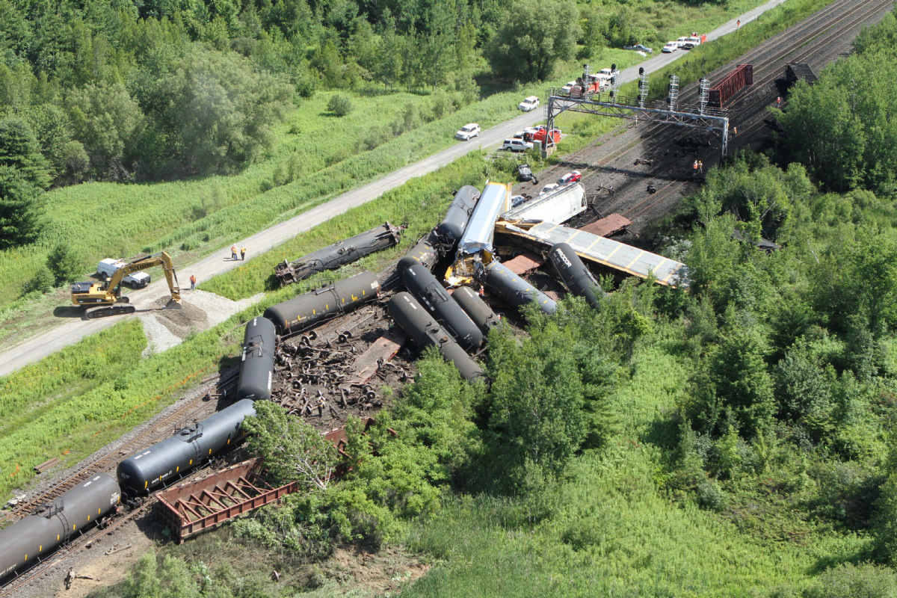
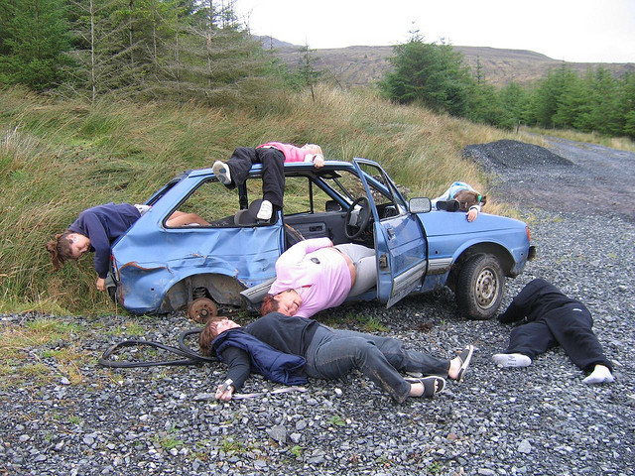

Slide 32
We need something new!
PREDICTIVE MANAGEMENT
EMPIRICAL MANAGEMENT
Long-term detailed plans
Assign and control the work
Maximize capacity and effort
Keep all on schedule
Driven by meetings and reports
Intervene to fix all problems
Provide external motivators ($, job title)
Goals, vision, direction
Foster the environment
Help remove impediments
Attend Sprint Reviews
Share incremental feedback
Manage for value
Autonomy, mastery, purpose
Notes:
Can relate this back to the right process and leadership style to fit the problem.

Slide 33
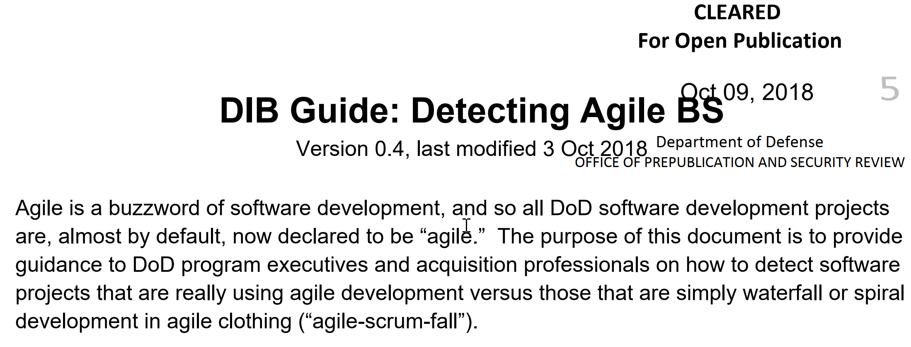

Who Gets it?
https://nkdagility.net/DOD-Detecting
Notes:
2.86 million employees
$738 billion budget

Slide 34
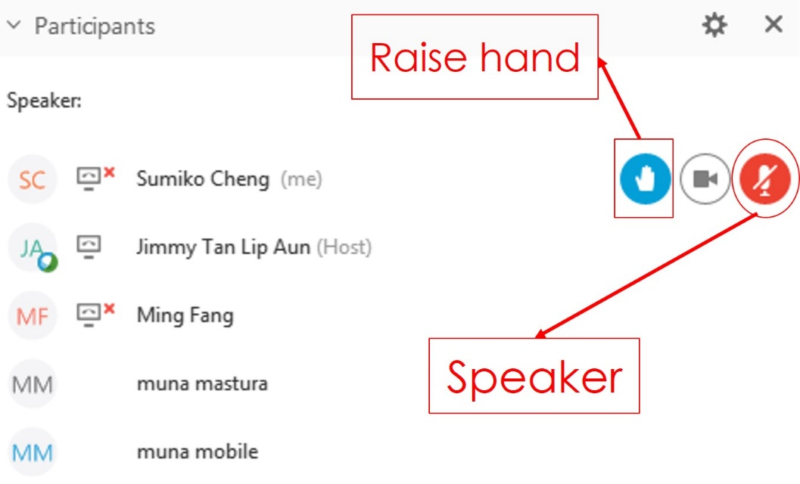
How many agile teams, according to the DOD definition do we have in the room.
Participation
Raise your hand
You will be asked 6 questions. After each question, if your answer is “no” then lower your hand.
Let’s see who still has their hand raised at the end!
Try to be honest! If you are not sure, or are thinking “yes, but” then the real answer is likely “No”

Slide 35
Are teams delivering working software to at least some subset of real users every iteration (including the first) and gathering feedback?
NO?
@MrHinsh

Slide 36
Is there a product charter that lays out the strategic goals? Do all members of the team understand, and are they able to see how their work contributes?
NO?
@MrHinsh

Slide 37
Are teams empowered to change their process based on what they learn?
NO?
@MrHinsh

Slide 38
Is feedback from users turned into concrete work items for sprint teams on timelines shorter than one month?
NO?
@MrHinsh

Slide 39
Are teams empowered to change the requirements based on user feedback?
NO?
@MrHinsh

Slide 40
Is the full ecosystem of your project agile? (Agile programming teams followed by linear, bureaucratic deployment is a failure.)
NO?
@MrHinsh

Slide 41
For a team working in agile, the answer to all these questions should be a resounding “yes.”

Slide 42
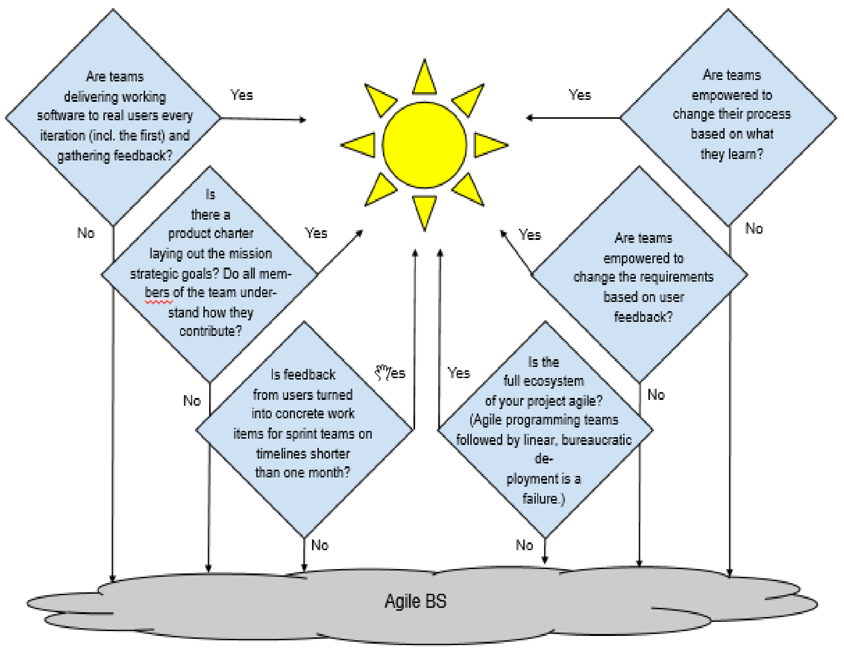

Slide 43
“Using agile practices small projects are 32% more likely to succeed…
…and large projects are 600% more likely.”
Chaos Report, Standish Group
Notes:
This may seam counter intuitive but can you really be honest about the practices that you use….

Slide 44
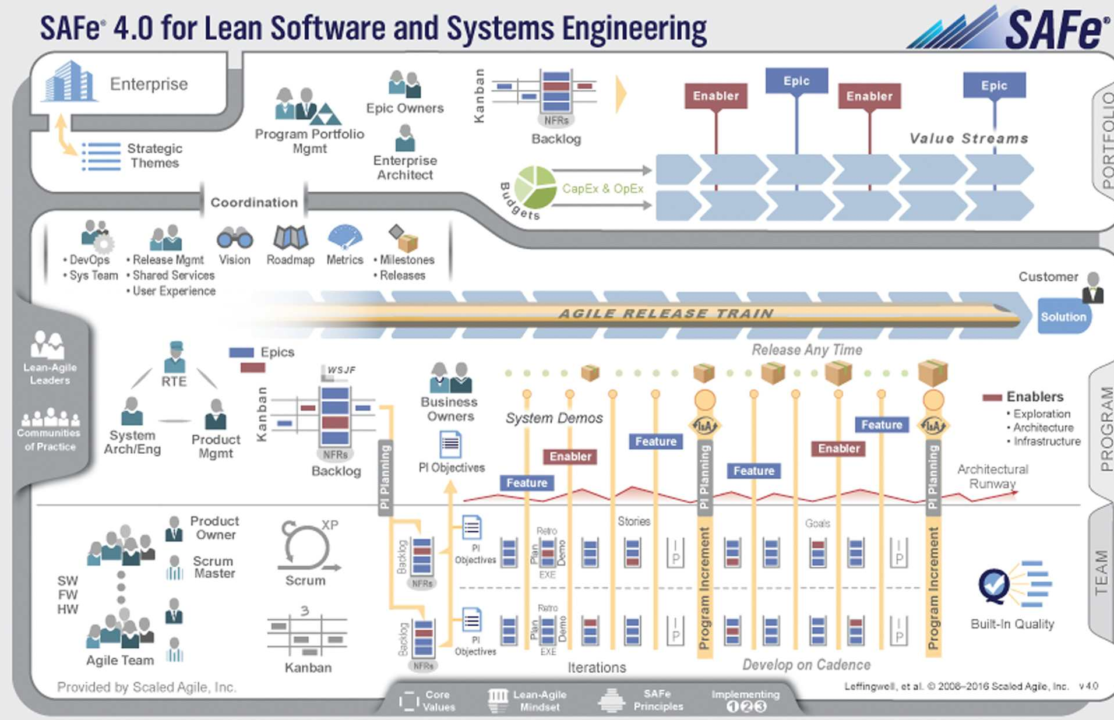
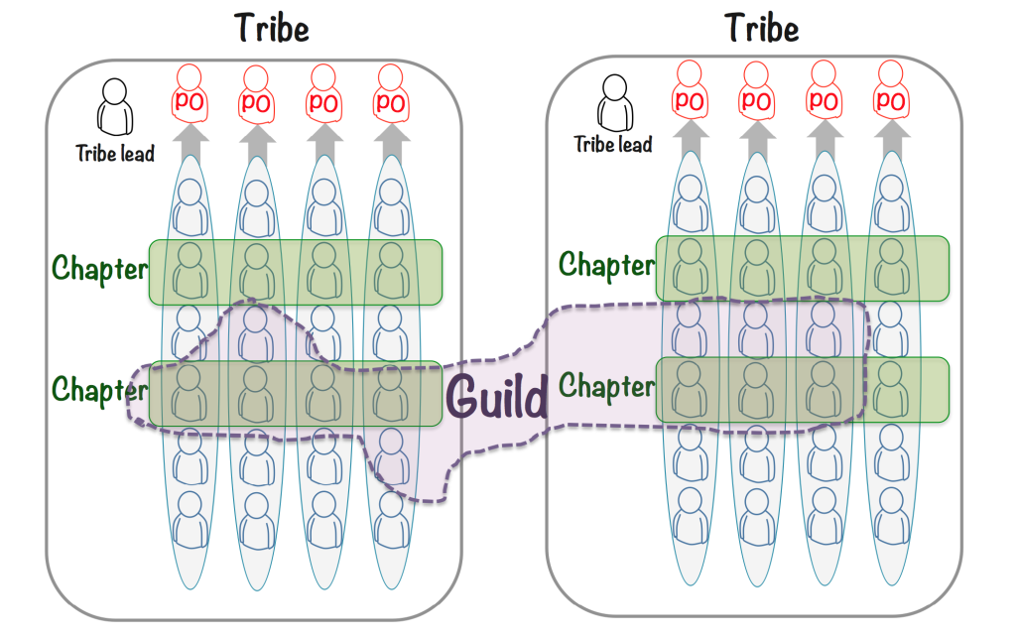
You can't use someone else's process
But you can be inspired by it!

Slide 45
Questions about the Agile / SAFe Memo?
The CSO signed a Memorandum for Record on Nov 26th 2019, sent to all PEOs and PMs regarding the use of DevSecOps and Agile and highly discouraging from using rigid, prescriptive frameworks such as the Scaled Agile Framework (SAFe).
Why?
DoD is still using Waterfall or Water-Agile-Fall so until we can truly implement basic Scrum/Kanban, there is nothing to « SCALE ». Agile should be applied across the entire Program, not just the development team, that includes: Contracting, Program Management, Reporting to leadership (no EVM) etc!
You cannot scale if you don’t have the “basics” right. At best, such frameworks put us at risk to fall back to what we know and go back to Waterfall because of their “mapping”.
SAFe might potentially be an useful framework for teams which do not use DevOps/DevSecOps but a key principle of DevSecOps is to decouple work and teams and the only synchronization required should be across Product Owners. Teams shouldn’t have to coordinate if they use a Service Mesh/Domain Driven Design/Microservices model. This doesn’t require a rigid framework. If you’re having issues implement this, you’re not implementing the right DevSecOps model.
Take what is best from any framework and make it work for your team! Certifications aren’t always the answer!
Fundamentally, the main “goal” of Software development is NOT to be « SAFE », it is to INNOVATE and CREATE. You do not create by not taking risks… it is quite the opposite:
« Continuous Learning: Fail Fast but don’t Fail twice for the same reason! » - Small incremental changes which mitigate risks and create safe conditions to implement rapid changes.
SAFe isn’t used by any successful software commercial organization (Facebook, Google, Netflix, etc.).
Bloated overhead functions (Waterfall-like)
Looking to coordinate your Product Owners’ work? Multiple models exist such as Scrum of Scrum etc. This shouldn’t impact the developers.

Slide 46


DevOps & Agile are not magic
Notes:
Ours has been a journey of continuous, iterative improvement to our development process. We’ve still got a lot to learn and we still keep making mistakes. But we have come a long way

Slide 47

@MrHinsh
martinhinshelwood
Tyranny of Taylorism
nakedagility.tv
How to spot agile BS!
Notes:
Hi, my name is Martin Hinshelwood and I run Naked Agility with Martin Hinshelwood. I’m a professional scrum trainer with Scrumorg, Professional Kanban Trainer with ProKanban, and I have been a Microsoft MVP in DevOps for 13 years. Id like to take about the tyranny of Taylorism and how to detect agile bs!
I’d like to thank StackConf for this opportunity to talk to you. Please feel free to ask any questions in the chat, Ill be there, or at any time on twitter @MrHinsh. You can even find many other webcasts of mine on nakedagility.tv. I’ll be providing a link to the presentation at the end that will include much more information about the Azure DevOps teams evolution to agility/.

Slide 48
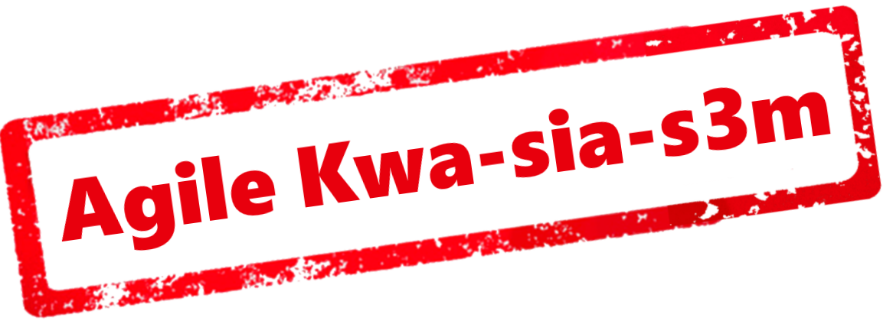
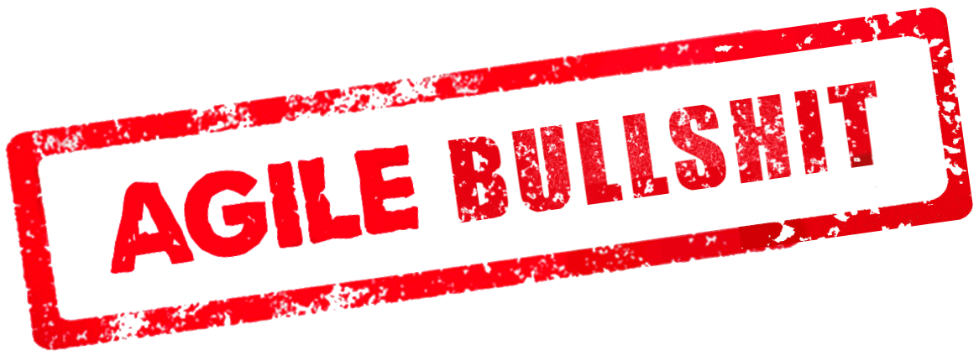
Agile n-Kwa-sia-s3m

